Slide 1
Software Development with UML and Java 2
Producer & consumer

Slide 2
Agenda
Problem introduction
Example – Folding @ home
Concept idea, producers, consumers, queue
Client-server-persistence example
Guarded blocks refresh
The blocking queue
Overview
Implementation requirements
Code
Using the Blocking queue
Wait & notifyAll explanation
Other examples

Slide 3
Producer & consumer
Used when multiple threads need to work together
You have Producer threads, which creates tasks of some kind
You have Consumer threads, which take tasks and perform them.
Notes:
From Wikipedia:
In computing, the producer–consumer problem^{[1][2]} (also known as the bounded-buffer problem) is a classic example of a multi-process synchronization problem. The problem describes two processes, the producer and the consumer, who share a common, fixed-size buffer used as a queue. The producer's job is to generate data, put it into the buffer, and start again. At the same time, the consumer is consuming the data (i.e., removing it from the buffer), one piece at a time. The problem is to make sure that the producer won't try to add data into the buffer if it's full and that the consumer won't try to remove data from an empty buffer.
The solution for the producer is to either go to sleep or discard data if the buffer is full.
The next time the consumer removes an item from the buffer, it notifies the producer, who starts to fill the buffer again. In the same way, the consumer can go to sleep if it finds the buffer empty.
The next time the producer puts data into the buffer, it wakes up the sleeping consumer. The solution can be reached by means of inter-process communication, typically using semaphores. An inadequate solution could result in a deadlock where both processes are waiting to be awakened. The problem can also be generalized to have multiple producers and consumers.

Slide 4
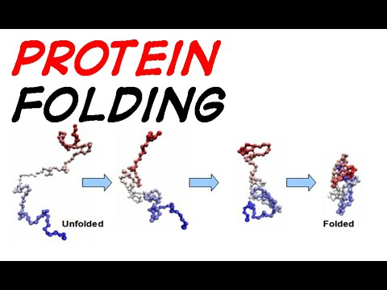
Example Folding@Home
Protein folding
Biology, calculating what folded protein looks like can require large computation time.
A project would make people set up their Playstation 3 to fetch a folding task, compute the task, send back the result.
Notes:
Some types of proteins bends and folds in on itself, and in some areas of bio-informatic research it’s interesting to compute these folds.
There was a project where people could lend the computational power of their play station 3s to compute these protein folds.

Slide 5


Request task
Send result
Notes:
When you didn’t use your PS3, you could allow the folding@home project to use it. The PS3 would connect to a server somewhere, retrieve a compute-protein-folding task, execute this task, and send the result back again.
In this case, the Server would produce folding tasks, and the PS3s (consumers) would retrieve and perform these tasks.

Slide 6
P
Task queue
P
P
P
Notes:
The Producer-Consumer setup needs a way of communicating, this is where we use a special kind of queue: Blocking Queue.
In my example here, the Producers will create tasks: two numbers need to be added together.
Consumers will retrieve tasks, execute the task, and print out the result.
Yes, fairly simple example, but the setup and idea is the same.

Slide 7
C
P
Task queue
C
P
C
P
C
P
Notes:
These are producer threads, they produce the tasks. There can be any number of producer threads.

Slide 8
P
C
Task queue
P
P
C
P
C
C
Notes:
These are my consumer threads, again, any number is valid.

Slide 9
Producers produce the tasks
Consumers retrieve the tasks, and performs them.
In our example, we just want to add numbers together, and print result.

Slide 10
P
C
Task queue
P
P
C
P
C
C

Slide 11
P
3, 7
C
Task queue
P
P
C
P
C
C
Notes:
The producer threads will continuously create tasks.

Slide 12
P
C
Task queue
P
3, 7
P
C
P
C
C
Notes:
These tasks are put into the queue.

Slide 13
P
C
Task queue
P
2, 1
3, 7
P
6, 1
C
P
C
C
Notes:
Multiple producer creates tasks, but only one producer can actually insert a task at a time. Other threads will have to wait their turn for insertion.
While there is nothing in the Blocking Queue, the Consumers are just ‘idling’, not doing anything.

Slide 14
P
C
Task queue
P
3, 7
P
6, 1
C
2, 1
P
C
C

Slide 15
P
C
Task queue
P
3, 7
P
C
2, 1
P
6, 1
C
C

Slide 16
P
C
Task queue
3, 7
P
2, 1
P
C
6, 1
P
C
C
Notes:
Every time a task is added, the waiting Consumers are notified, and one of them will retrieve a task, and perform it.

Slide 17
P
10
C
Task queue
P
2, 1
P
C
6, 1
P
C
C
Notes:
Task (3,7) is computed, the result, 10, is printed out.
The other Consumers are also retrieving tasks, but that’s challenging to show in the slide show. Only one Consumer at a time can retrieve a task.
When a task is retrieved, others can also retrieve a task, while the first is performing said task.
So we can execute the tasks in parallel, on multiple threads, but only one thread at a time can interact with the Blocking Queue.

Slide 18
P
10
C
Task queue
P
2, 1
P
C
6, 1
P
C
C

Slide 19
P
C
Task queue
P
6, 1
2, 1
P
C
P
3, 4
C
C
Notes:
More tasks are created and more tasks are retrieved.

Slide 20
P
C
Task queue
P
6, 1
P
3
3, 4
C
P
C
C
Notes:
Adding the created task. Also printing out the result of a task performed

Slide 21
P
C
Task queue
P
6, 1
P
3
3, 4
C
P
C
C

Slide 22
P
C
Task queue
P
6, 1
P
C
3, 4
P
C
Producers
Consumers
Blocking queue
C

Slide 23


Slide 24
Agenda
Problem introduction
Example – Folding @ home
Concept idea, producers, consumers, queue
Client-server-persistence example
Guarded blocks refresh
The blocking queue
Overview
Implementation requirements
Code
Using the Blocking queue
Wait & notifyAll explanation
Other examples

Slide 25

Client
Client
Client
Server
Assuming older type database with little synchronization
DBThread
Notes:
This example is about multiple clients wanting to interact with the Server’s persistence. Most modern database have their own internal multi-thread synchronization, but imagine the didn’t, or you just stored the data in file. In that case, the Server would have to handle access to the file.

Slide 26
Client
Client
Client
Add
Data1
Add
Data2
Add
Data3
Server
DBThread
Notes:
So here the Clients are considered Producers: they produce data, which they want added to the database.

Slide 27
Client
Client
Client
Server
Add
Data1
Add
Data2
Add
Data3
DBThread
Notes:
The database will put these tasks in its blocking queue. We then have a single DBThread, our Consumer, which will take the tasks from the Blocking queue, and execute them.
The example could be expanded for Get data tasks.
Now we have secured the access to our database/file.

Slide 28
Agenda
Problem introduction
Example – Folding @ home
Concept idea, producers, consumers, queue
Client-server-persistence example
Guarded blocks refresh
The blocking queue
Overview
Implementation requirements
Code
Using the Blocking queue
Wait & notifyAll explanation
Other examples

Slide 29
Do we remember Lock objects?

Slide 30
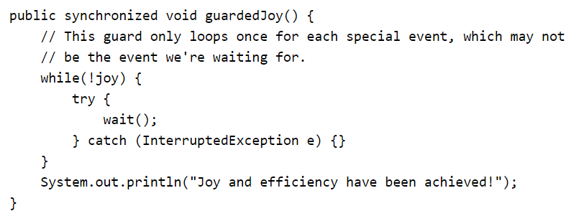
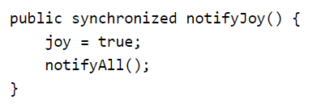
Guarded blocks
wait() occasionally wakes up automatically, so it must be a while loop, rather than an if-statement!
Somewhere else the state changes, in this case ‘joy’, so we notifyAll to wake up waiting threads.
Notes:
A guarded block is to make sure a thread is not allowed to execute some functionality unless certain conditions are met.
In the simple example above, the “Joy and efficiency have been achieved” can only be printed out, if joy = true.
If joy = false the thread calling the guardedJoy method will go into the while loop, and call wait(). This puts the thread in a waiting state, where it does nothing.
When wait() is called, the thread also releases the class’ lock, so that other threads may call the synchronized methods on this class.
When the state of the class is changed, in this case joy is changed to true, then we want to let all waiting threads know that something has changed, which means they may now be allowed to perform whatever code they were trying to perform.
We notify the waiting threads about this change with the notifyAll() method call. One of the waiting threads will then acquire the lock, and check its condition in the while loop again. If the condition hasn’t changed, it’ll wait once more. If the while-condition has changed, it will exit the while loop, and execute the following code.
So the guarded block (the while-loop-with-a-wait) is a way to prevent threads executing certain code, until the condition is right.

Slide 31


Slide 32
Agenda
Problem introduction
Example – Folding @ home
Concept idea, producers, consumers, queue
Client-server-persistence example
Guarded blocks refresh
The blocking queue
Overview
Implementation requirements
Code
Using the Blocking queue
Wait & notifyAll explanation
Other examples

Slide 33
Blocking queue, overview
May have a limited number of cells
Producers can insert. If there’s no room, they will wait.
Consumers will retrieve. If there’s no task, they will wait.
Notes:
Most descriptions of the Blocking Queue says it is bounded, similar to the Queues you used in the Test session. They have a max capacity.

Slide 34
Blocking queue, impl requirements
We need a specific kind of queue
It must be thread safe
It must make threads wait, if there is no more room in the queue
It must make threads wait, if they try to retrieve something from an empty queue
Notes:
Java actually has a Blocking Queue, but we’re making our own to understand the mechanics.

Slide 35
Blocking queue
package blockingqueueexample; import java.util.LinkedList; import java.util.Queue; public class BlockingQueue { private Queue<Task> queue = new LinkedList<>(); private int capacity = 10; public synchronized void put(Task t) { while(queue.size() >= 10) { try { wait(); } catch (InterruptedException e) { e.printStackTrace(); } } queue.add(t); notifyAll(); } public synchronized Task take() { while(queue.size() <= 0) { try { wait(); } catch (InterruptedException e) { e.printStackTrace(); } } notifyAll(); return queue.poll(); } }
Default size.
Could set this through a constructor.
Notes:
In the BoundedArrayQueue from the test session, we implemented the queue functionality ourselves (or I did for you). In this case, we’re not much interested in that part, and just reuse a Queue existing in Java. We will use the functionality of this Queue, and add our extra layer of guarded blocks to make the Queue into a Blocking Queue. We could consider this an adapter pattern, if our BlockingQueue had an interface. Then the adaptee is the Queue. We’ll actually be doing this in the next assignment.
The Queue in the code is an interface. I instantiate it to be a LinkedList.
I hardcode the capacity to 10 here. It would usually be good practice to get this capacity through the constructor.
Extra info:
The ArrayList and LinkedList both implement the List interface, so they can provide the same functionality. They just implement this functionality in different ways. The ArrayList uses an Array, the LinkedList uses something called a Linked Structure, you’ll see more about this on the 4th semester in “Algorithms and Data Structures”. The ArrayList does not implement the Queue interface, which is why I use the LinkedList here instead. Because of the difference in implementation between the ArrayList and LinkedList, the LinkedList is more efficient at providing the functionality of a Queue.

Slide 36
Blocking queue
package blockingqueueexample; import java.util.LinkedList; import java.util.Queue; public class BlockingQueue { private Queue<Task> queue = new LinkedList<>(); private int capacity = 10; public synchronized void put(Task t) { while(queue.size() >= capacity) { try { wait(); } catch (InterruptedException e) { e.printStackTrace(); } } queue.add(t); notifyAll(); } public synchronized Task take() { while(queue.size() <= 0) { try { wait(); } catch (InterruptedException e) { e.printStackTrace(); } } notifyAll(); return queue.poll(); } }
Why the while loop?
What does wait do?
What does notifyAll do?
Notes:
Using a guarded block here.
I should only be allowed to put a Task into the BQ, if there is actually room for it. So in the while-loop condition, I check if there’s room in the queue. If not, then the Thread waits, and releases the lock. If there is room, the while is skipped, and we call queue.add(t), and then notify all waiting threads, that something has changed.
We use the while loop instead of an if-statement, because threads “wake up” from their waiting on various occasions, and every time a thread wakes up, it must check whether it is allowed to proceed, or if it should just wait again. Had I used an if-statement instead of the while, my program would not perform as intended.
Wait() puts the thread to sleep, or in an idle state. The thread is blocked, and isn’t doing anything. It also releases the lock. If you want to call wait(), then the method must be synchronized.
notifyAll() wakes up all waiting threads. One of them then acquires the Lock. The threading framework behind everything handles this, we have no control. The other threads go back to waiting.

Slide 37
package blockingqueueexample; import java.util.LinkedList; import java.util.Queue; public class BlockingQueue { private Queue<Task> queue = new LinkedList<>(); private int capacity = 10; public synchronized void put(Task t) { while(queue.size() >= capacity) { try { wait(); } catch (InterruptedException e) { e.printStackTrace(); } } queue.add(t); notifyAll(); } public synchronized Task take() { while(queue.size() <= 0) { try { wait(); } catch (InterruptedException e) { e.printStackTrace(); } } notifyAll(); return queue.poll(); } }
Blocking queue
Dequeue, take the next element out of the queue
Notes:
Same idea here. A consumer thread can only take a Task from the BQ, if there is actually something in the queue. So another guarded block, with an appropriate condition.
At the end, we notify all waiting threads, that something changes, and use poll(), to get the next element out of the queue. We called this method dequeue last time.

Slide 38


Slide 39
Agenda
Problem introduction
Example – Folding @ home
Concept idea, producers, consumers, queue
Client-server-persistence example
Guarded blocks refresh
The blocking queue
Overview
Implementation requirements
Code
Using the Blocking queue
Wait & notifyAll explanation
Other examples

Slide 40
Let’s finish the example
*Clack*
Create two thread types:
Producer to create tasks
Consumer to retrieve and perform tasks
*Click*
T

Slide 41


Slide 42
Agenda
Problem introduction
Example – Folding @ home
Concept idea, producers, consumers, queue
Client-server-persistence example
Guarded blocks refresh
The blocking queue
Overview
Implementation requirements
Code
Using the Blocking queue
Wait & notifyAll explanation
Other examples

Slide 43
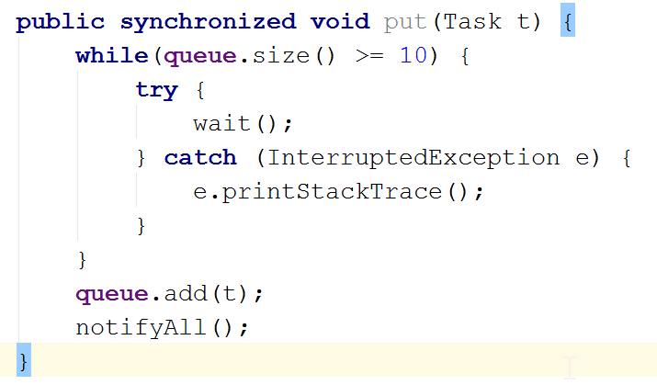
Synchronized and wait
T1
entry
owner
waiting
Notes:
This is a slightly more elaborate explanation of how the wait-notify works.

Slide 44
Synchronized and wait
T1
entry
owner
T1 attempt to call method
waiting

Slide 45
Synchronized and wait
entry
T1
owner
T1 attempt to call method
waiting

Slide 46
Synchronized and wait
T2
entry
owner
T1
Because no other thread has the lock, T1 receives the lock
waiting

Slide 47
Synchronized and wait
T2
entry
owner
T1
T2 attempts to call the method
waiting

Slide 48
Synchronized and wait
entry
T2
owner
T1
The lock is owned by T1, so T2 is blocked, and is in the entry set.
waiting

Slide 49
Synchronized and wait
entry
T2
owner
T1
T2 checks condition
waiting

Slide 50
Synchronized and wait
entry
T2
owner
T1
Figures out it has to wait
waiting

Slide 51
Synchronized and wait
entry
T2
owner
Figures out it has to wait
waiting
T1

Slide 52
Synchronized and wait
entry
T2
owner
T1 releases the lock, and T2 can call the method
waiting
T1

Slide 53
Synchronized and wait
entry
owner
T2
T2 now owns the lock
waiting
T1

Slide 54
Synchronized and wait
T3
entry
owner
T2 realizes it must also wait.
waiting
T2
T1

Slide 55
Synchronized and wait
T3
entry
owner
T3 attempts to call method
waiting
T2
T1

Slide 56
Synchronized and wait
entry
T3
owner
T3 attempts to call method
waiting
T2
T1

Slide 57
Synchronized and wait
entry
T3
owner
A notifyAll() call is made. All threads in the entry and wait set now “fight” for access.
waiting
T2
T1

Slide 58
Synchronized and wait
entry
T3
owner
T2
T2 won, and continues
waiting
T1

Slide 59
Synchronized and wait
entry
T3
owner
T2
At some point T2 finishes, calls notifyAll() and the waiting threads fight again.
waiting
T1

Slide 60
Synchronized and wait
entry
owner
T3
T3 acquires the lock, calls the method
waiting
T1

Slide 61
Synchronized and wait
entry
owner
T3
Doesn’t have to wait
waiting
T1

Slide 62
Synchronized and wait
entry
owner
T3
Adds the task
waiting
T1

Slide 63
Synchronized and wait
entry
owner
T3
Notifies all about a change
waiting
T1

Slide 64
Synchronized and wait
entry
owner
T3
Finished the method call
waiting
T1

Slide 65
Synchronized and wait
entry
owner
T1 is woken up by the notifyAll.
waiting
T1

Slide 66
Synchronized and wait
entry
owner
T1
Can continue…
waiting

Slide 67


Slide 68
Agenda
Problem introduction
Example – Folding @ home
Concept idea, producers, consumers, queue
Client-server-persistence example
Guarded blocks refresh
The blocking queue
Overview
Implementation requirements
Code
Using the Blocking queue
Wait & notifyAll explanation
Other examples

Slide 69

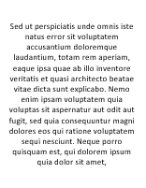


Printing documents
Notes:
Just another example of producer & consumer. The laptops send documents to be printed. The printer then has a queue, where these print-tasks are inserted, and then “consumes” one task at a time, printing it out.

Slide 75










Airport pass control
Notes:
A more real life example: Passport control at an airport. We have to passport controllers, employees of the airport. The queue where people wait for an available employee is our BlockingQueue. The producers can be considered the travelers, so they are so of both producers and the tasks.

Slide 76
Airport pass control

Slide 77
Airport pass control

Slide 78
Airport pass control

Slide 79
Airport pass control

Slide 80
Airport pass control

Slide 81
Airport pass control

Slide 82
Airport pass control

Slide 83
Airport pass control

Slide 84
Airport pass control

Slide 85
Airport pass control

Slide 86
Airport pass control

Slide 87
Airport pass control

Slide 88
Airport pass control

Slide 89
Airport pass control

Slide 90
Airport pass control

Slide 91
Assignment 2 introduced at 11:20

Slide 92

Who’s out there stumbling around in the dark?

Slide 93

S

